Slide 1
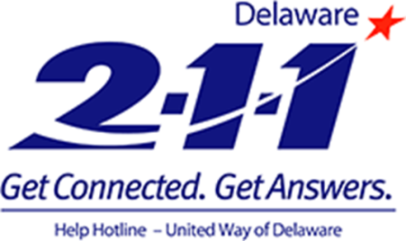





Strengthening Links to Community Services

Slide 2

De 211 Video https://www.youtube.com/watch?v=k9Kzc0WxUBw

Slide 3
Today’s Agenda
Overview 2-1-1
  National Network
  Delaware Statewide System
De2-1-1 Video
Community Needs and Assets
Guided and Keyword Search
Data Dashboard: Delaware 2-1-1 Counts
Questions
Notes:
Read slide

Slide 4
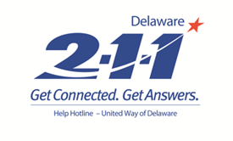
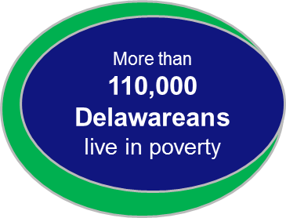
Community Needs Are Complex.
Public Assistance
Taxes
Abuse/Neglect
Legal
Bullying
Home Repair
Toxic Stress
Heart Disease
Housing
Education
Developmental/Behavioral Health
Senior Care
Homelessness
Government Assistance
Insurance
ADHD
Utility Assistance
Oral Health
Diapers
Addiction/Substance Abuse
Translation Services
Transportation
Homecare
Foster Parent
Diabetes
Family Counseling
Clothing
Foreclosure
Cancer Services
Emergency Food
Prescription Assistance
Donations
Transitional Housing
Child Care
Notes:
Everyone in this room knows that the needs from our communities are diverse and complex. An unforeseen financial crisis brought on by an accident, medical problem, loss of income or rising food and fuel prices can cause a family with children or a senior citizen to fall into a crisis situation. In addition, people find it frustrating and confusing to access community services. 2-1-1 makes access to services easy, but we don’t do this work alone.

Slide 5
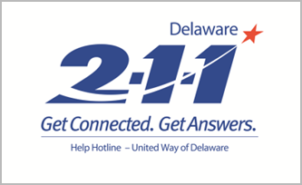

What is 2-1-1?
2-1-1 is an easy to remember three-digit number that connects people to critical health and human service programs in their community.
  Easy to access.
  Free and confidential.
  Eliminates need for numerous 800#s.
  Connects individuals/families to local resources by Zip Code.
  Confirms met needs.
  Maximizes use of health and human services programs, non-profit, government agencies and other organizations.
  Provides additional insights to community needs.
  Expands supports in the aftermath of a disaster.
Notes:
LOCALLY – READ
Similar to the national 911 program that’s mission is to provide coordination in supporting and promoting emergency services (police, fire and rescue) across the united states, the 211 system was designed to provide a universal, easy-to-remember number for people to reach critical health and human service programs from any phone, in any location, and without having to look up specific phone numbers.
2-1-1:
Easy to access.
Free and confidential.
Eliminates numerous 800#s.
Uses Zip Codes to connect Delawareans to local programs/services.
Confirms and documents met and “unmet” needs.
Improves coordination of the entire human services sector at every level.

Slide 6
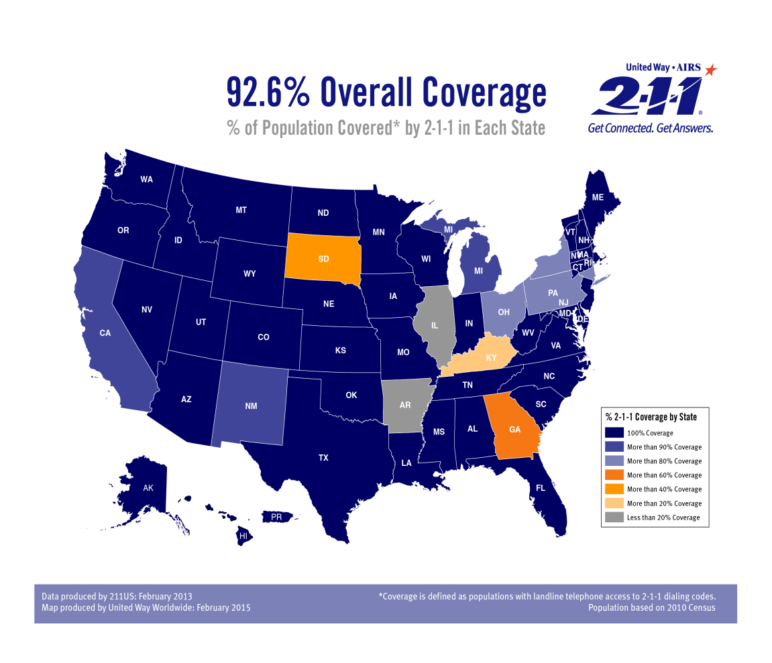
Why 2-1-1?
One Number. Easy Access to Services.
A National System
94%
One 2-1-1 national platform
Strengthens national safety net
Leverages evidence-based and best practices for stronger communities
National quality standards and performance measures
Notes:
Dark Blue = States with 100% coverage
Light Blue = States with 90% coverage
Very Light Blue = States with 80% coverage
Dark Gold = States with 60% coverage
Light Gold = States with 40% coverage
Light Gray = States with Less than 20% coverage

Slide 7
Why 2-1-1? National Impact - CY2017
A National System
94%
13.4 million calls answered
Almost 1 million texts, web chats, and emails.
Available to 94% of the U.S. population
Delaware 2-1-1 is actively engaged at the national level: 2-1-1 US National Network Steering Committee and United Way Worldwide National Operating Group
Notes:
Dark Blue = States with 100% coverage
Light Blue = States with 90% coverage
Very Light Blue = States with 80% coverage
Dark Gold = States with 60% coverage
Light Gold = States with 40% coverage
Light Gray = States with Less than 20% coverage

Slide 8




2-1-1 Delaware: Our Mission
Delaware 2-1-1 supports the community by working collaboratively statewide to help Delawareans in need by connecting them to appropriate resources that lead to an acceptable resolution of identified concerns and advocate to reduce or eliminate gaps in services.
Notes:
2-1-1 supports the community by working collaboratively statewide to help Delawareans in need by connecting them to appropriate resources that lead to an acceptable resolution of identified concerns and advocate to reduce or eliminate gaps in services.

Slide 9






















2-1-1 Collaborates with Community Partners!

Slide 10

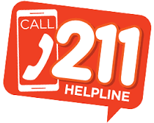
Start with 2-1-1. It’s one easy way to find help.
Immediate help Monday-Friday
8am-9pm
Utility Assistance
Food
Shelter
Multi-channel access: phone, website, chat, or text
Addiction
Elder Care
Special care for vulnerable populations
Health
Taxes
Integrated Telephony & Database System
Housing
Suicide Prevention
Government Agencies
Knowledgeable referral specialist captures met and unmet needs
From crisis to every day needs, 2-1-1 supports our communities.

Slide 11






Types of Referrals (Taxonomy & Key words)
50 Major Categories
150 Sub-Categories
  Basic Human Needs: utility assistance, rent, food, shelters.
  Physical and Mental Health: medical, drug and alcohol intervention, health insurance programs, Medicaid and Medicare, maternal health.
  Employment Support: unemployment benefits, financial assistance, job training, transportation assistance, education programs.
  Support for Older Citizens and Persons with Disabilities: Home health care, adult day care, Meals on Wheels, respite care, transportation, and home repair services.
  Support for Children, Youth and Families: quality childcare, after school programs, Head Start, summer camps, mentoring, protective services.
  Volunteer and donation opportunities.
Notes:
Delaware 211’s statewide database provides a comprehensive array of programs and services; arranged categories of need including but not limited to:
Basic Needs = food, shelters, utility assistance.
Physical and Mental Health = medical transportation
Employment = job training, education programs
Volunteer and Donation Opportunities

Slide 12

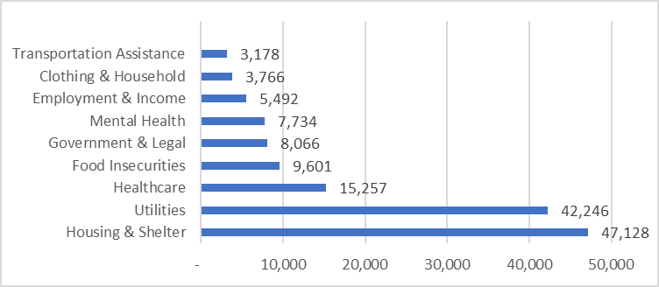
Delaware 2-1-1: Community Need Data
Total Number of Calls: 178,521
Total Number of Requests: 233,473
Top Zip Codes
19805
19802
19801
54%
Top Requested Categories
15%
14%
Jan 1, 2015 to Jan 1, 2018
Notes:
2-1-1 supports the community by working collaboratively statewide to help Delawareans in need by connecting them to appropriate resources that lead to an acceptable resolution of identified concerns and advocate to reduce or eliminate gaps in services.

Slide 13
Delaware 2-1-1: Greater Wilmington Data
Total Number of Calls: 96,401
Total Number of Requests: 126,075
54%
Top Zip Codes
19805
19802
19801
Jan 1, 2015 to Jan 1, 2018
Notes:
2-1-1 supports the community by working collaboratively statewide to help Delawareans in need by connecting them to appropriate resources that lead to an acceptable resolution of identified concerns and advocate to reduce or eliminate gaps in services.

Slide 14
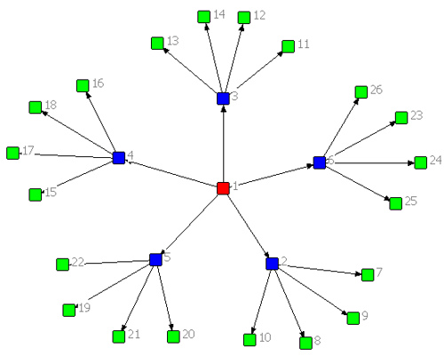
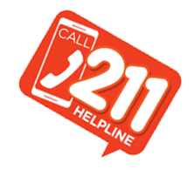
Delaware 2-1-1 Resource Database
Over 500 organization and agency providers
2,300 programs and services
Track met and unmet needs
Automatic Resource Verification & Updates
New Program Portal
National Quality Assurance & Standards
Data Privacy and Protection*
One Contact Connects to Thousands of Local Services!
Multiple certifications: SOC 1 (SSAE-16/CSAE-3416/ISAE 3402), PSI DSS for physical security standards and ISO 27001 & SOC2, type 2.
Notes:
Our system and data center possess multiple certifications, including:
SOC 1 (SSAE-16/CSAE-3416/ISAE-3402) type 2 audits
PCI DSS certified for physical security standards
ISO 27001 & SOC 2, type 2

Slide 15
2-1-1 Service Delivery Model
Level 1
Navigation & Referral
Level 2
Follow up & Care Coordination
Level 3
Personalized Care to Address Community Need or Population Health Concern

Slide 16

2-1-1 Access: Live Referral Navigators
Local referral Specialist assist callers 8am-9pm; Mon-Fri and most Holidays
Participate in various Community Outreach events statewide
Staff hold advance degrees and certified in Information and Referral core competencies

Slide 17
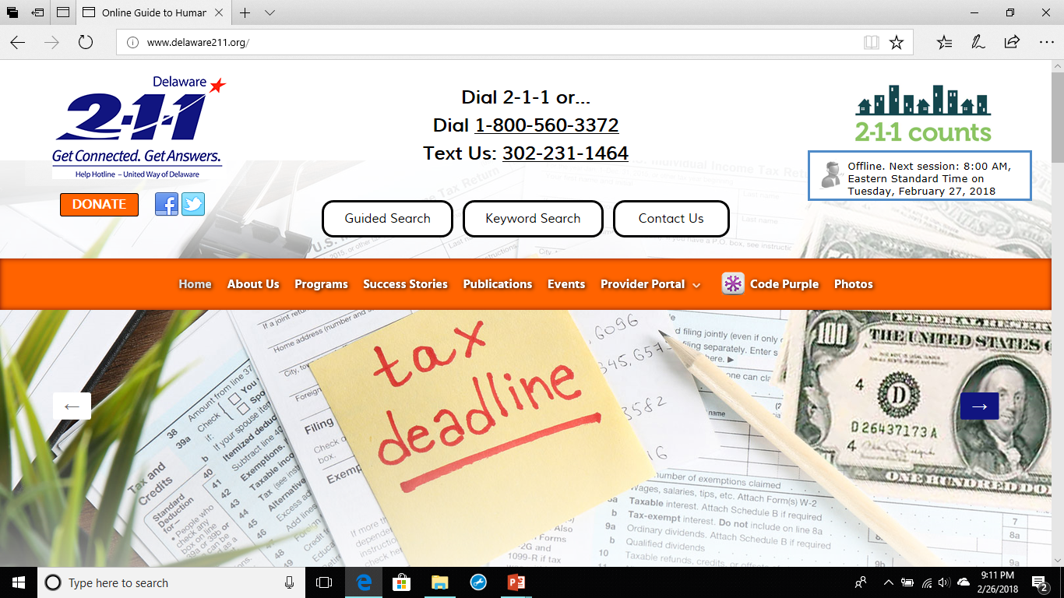
2-1-1 Access: Website Available 24/7

Slide 18
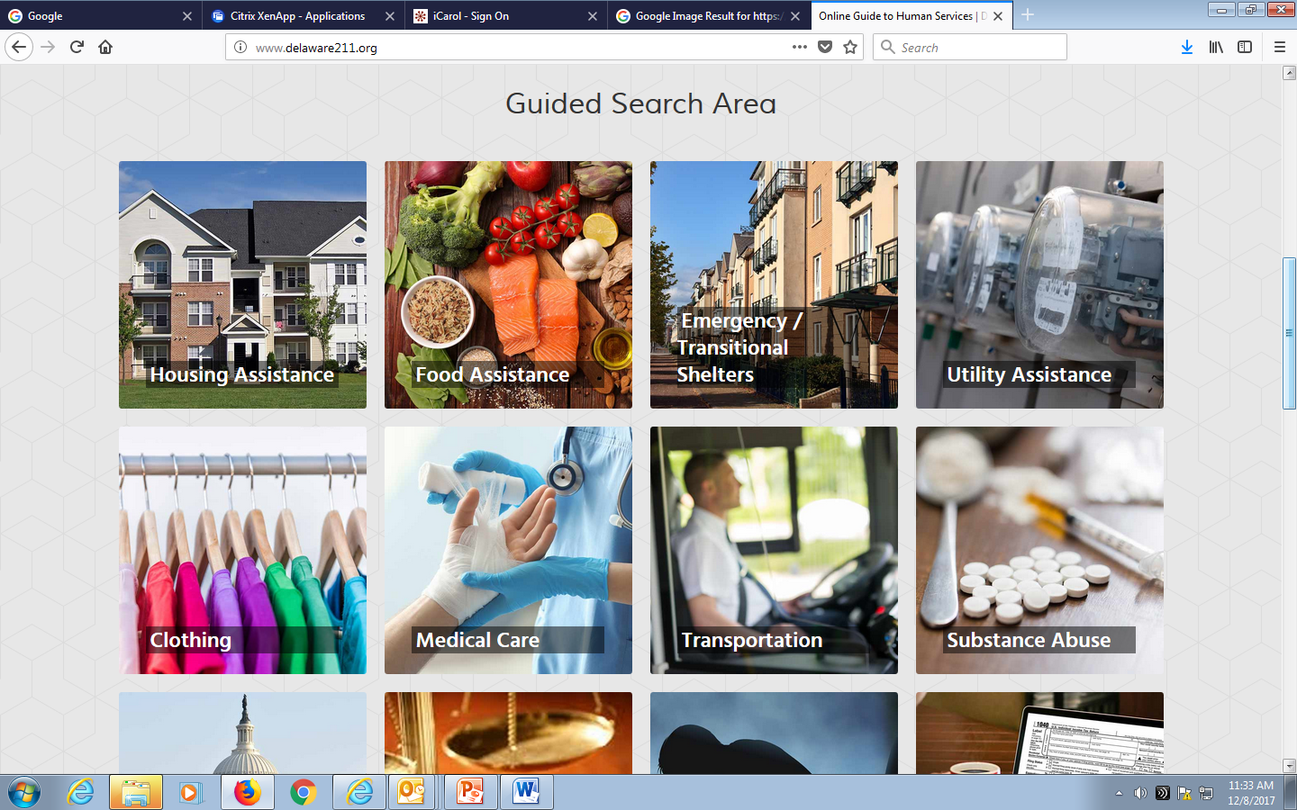

Slide 19
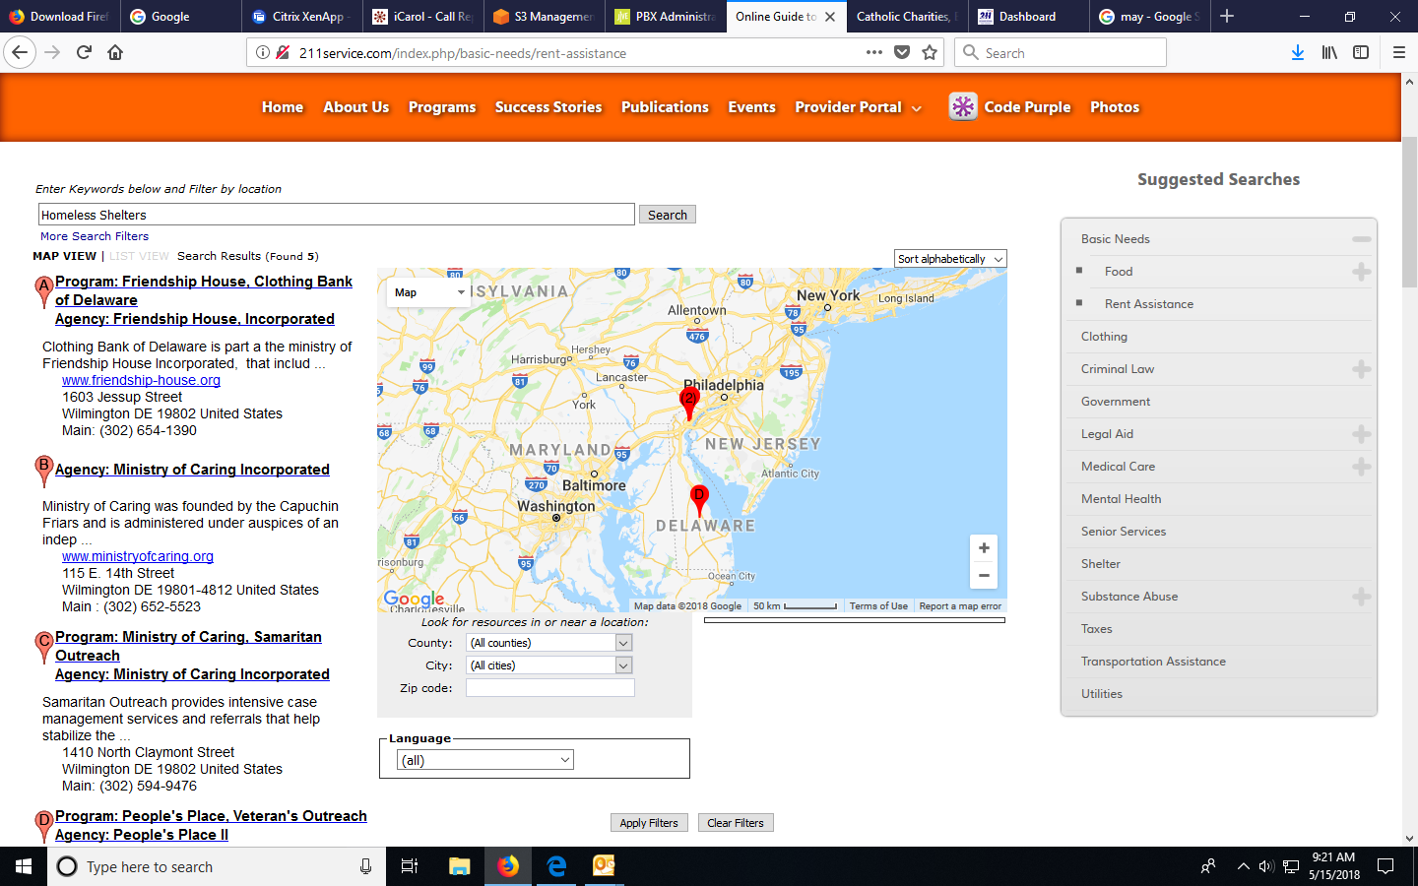
Guided Search Area

Slide 20
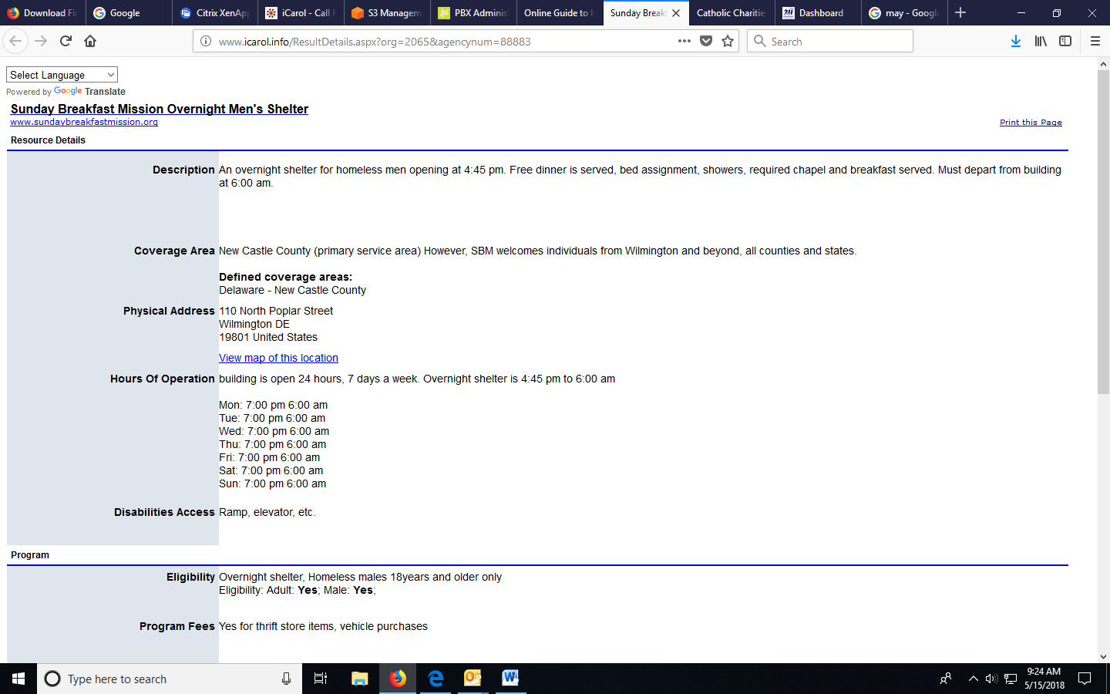
Guided Search Area

Slide 21
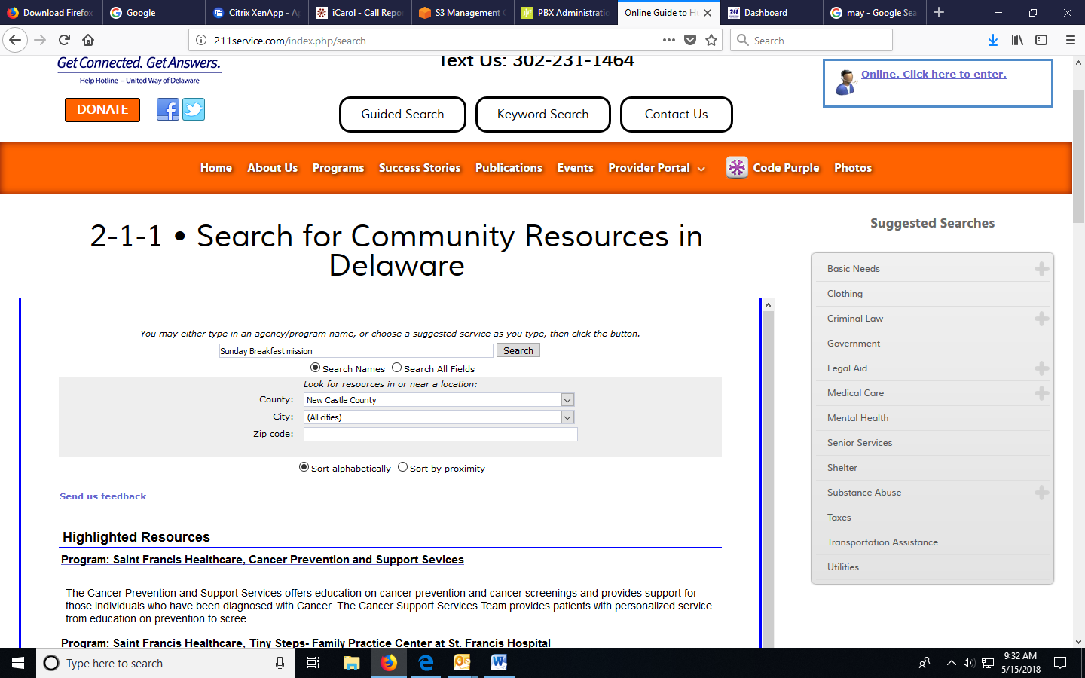
Keyword Search

Slide 22
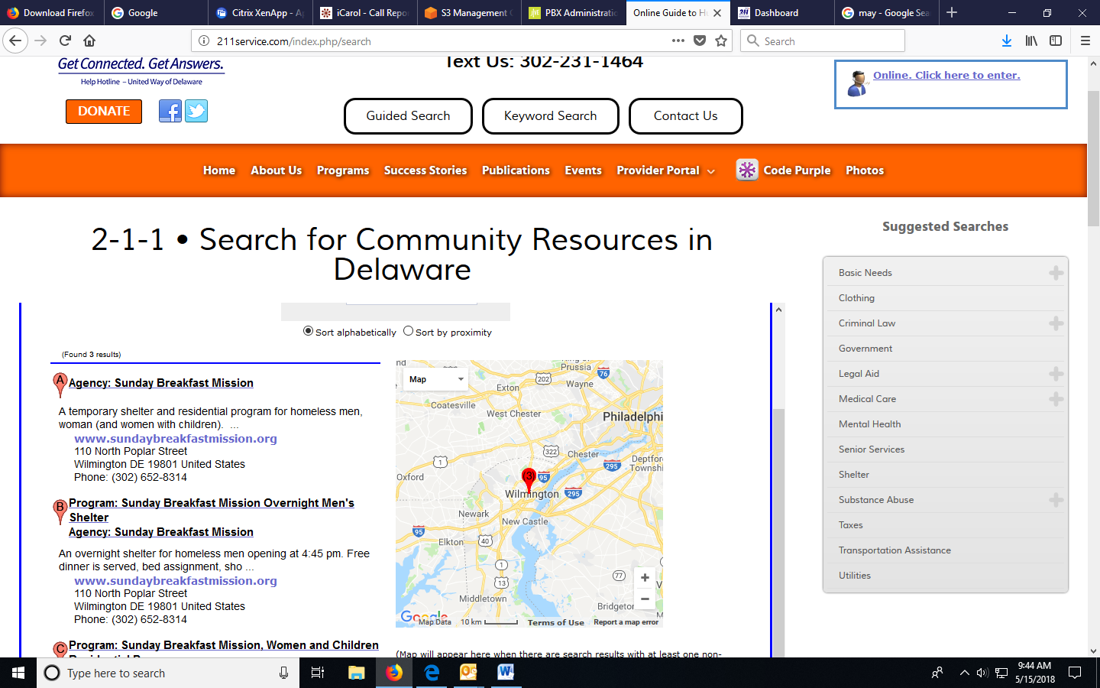
Keyword Search

Slide 23
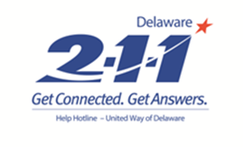
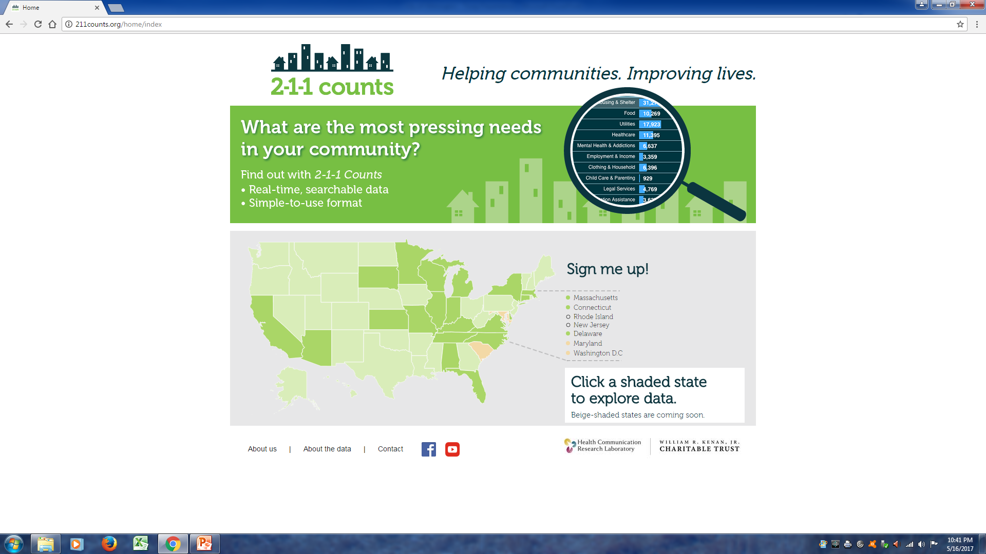
New Data Dashboard, 211 Counts
Provides real-time searchable and visual presentation of call data.
Community needs (requests) for services by:
  County
  Zip Code
  Congressional District
Maps needs and also displays Census information for:
  Poverty
  Unemployment
  Individuals without a High School Diploma
  Rental Housing
http://de.211counts.org
Notes:
READ SLIDE
Share address: http://de.211counts.org/

Slide 24
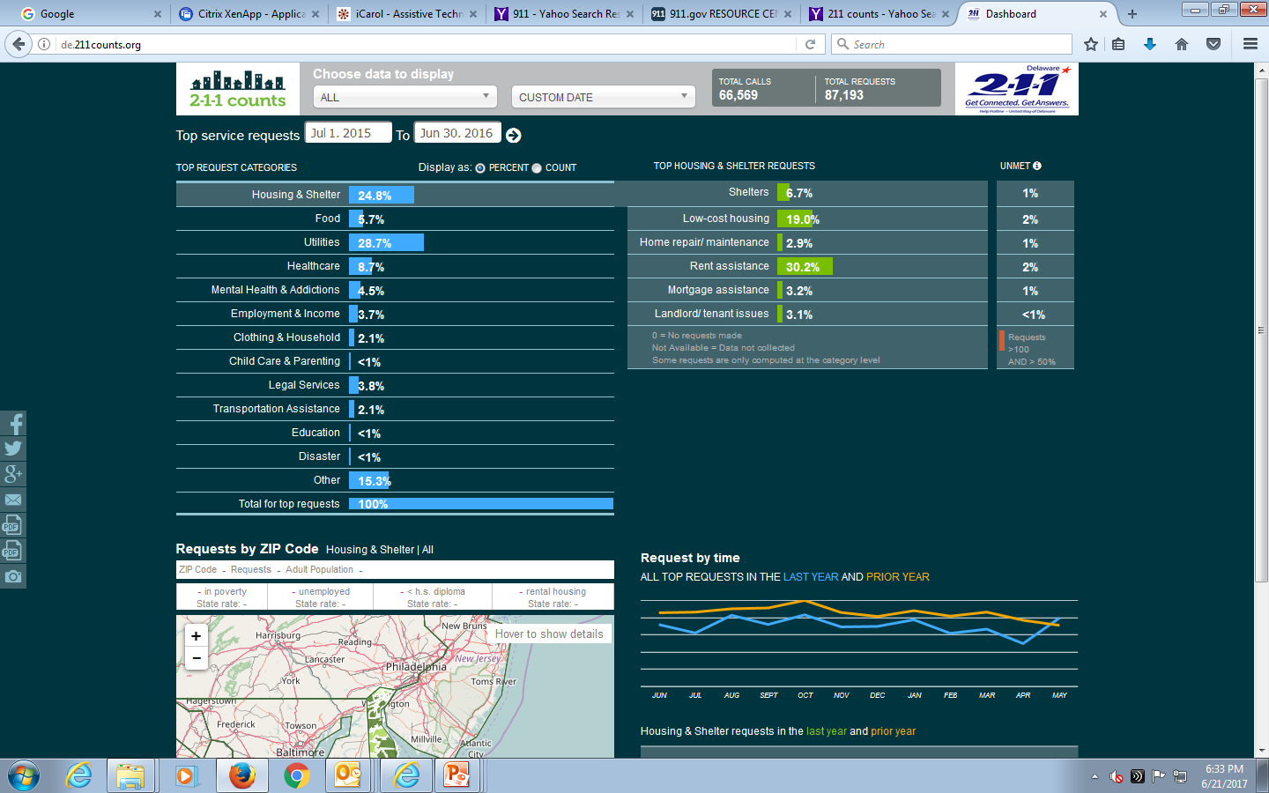
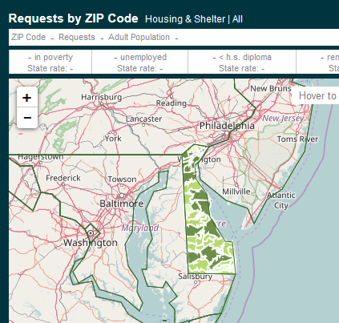
2-1-1 Data Dashboard visit de.211.counts.org
Menu Bar
Category Detail and Unmet Needs
Interactive Map of Needs by Zip Code and U.S. Census Data
Top Requested Services
(Calls only)

Slide 25

Questions & Next Steps

